Slide 1
Project Jaguar
Presentation to the Board of Directors
August 17, 2017

Slide 2
Executive Summary
Over the past year, Jaguar’s share price has barely changed, falling by ~33% (~$50) and then rising by ~50% (~$50) to its current level of $147.40 (there has also been little net change over the past ~3 years)
At its current levels, Jaguar is undervalued relative to Comparable Public Companies and on an intrinsic, cash-flow basis; Precedent Transactions and Premiums also imply a much higher share price
Jaguar’s promising portfolio, pricing power, and market position could make it an attractive acquisition candidate and allow it to achieve a significantly higher valuation in a deal
Such a strategy would allow Jaguar to maximize shareholder value, expand its geographic reach and distribution channels, and acquire more resources for future research & development and M&A activity
Given Jaguar’s unique attributes, we believe a purchase premium between 20% and 35%, implying share prices ranging from approximately $175 to $200, is possible
We recommend a highly targeted process focused on the most likely (“Tier 1”) potential partners, along with an outreach to Tier 2 potential partners while discussions with Tier 1 partners are ongoing

Slide 3
Summary of Jaguar Valuation
#1
Implied Valuation
Jaguar appears to be undervalued by 20-35%, depending on the methodology and selected year
#2
Comparable Public Companies
Despite significantly higher revenue growth, EBITDA growth, and EBITDA margins, Jaguar trades at a discount to the median EV / Revenue, EV / EBITDA, and P / E multiples of its peer companies
#3
Discounted Cash Flow (DCF) Analysis
Management forecasts indicate that Jaguar is moderately undervalued; consensus figures produce the opposite result, but all analyses exclude the value of potential synergies in an M&A deal
#4
Precedent Transactions
LTM EV / EBITDA multiples indicate an implied share price of $240+; Premiums indicate an implied value between $180 and $200 per share

Slide 4
Operational Assumptions for Jaguar
Management Forecast
Consensus Forecast
Xyrem Peak Sales
$3.8B in FY 22
$3.1B in FY 21
Erwinaze Peak Sales
$0.3B in FY 26
$0.3B in FY 26
Defitelio Peak Sales
$0.6B in FY 26
$0.5B in FY 26
Vyxeos and JZP-110 Sales
$1.6B total in FY 26
$1.1B total in FY 26
Operating Margins
40% declining to 25-30%
40% declining to 25-30%
WACC
10.0% declining to 7.5%
10.0% declining to 7.5%
Terminal Value
2.5% Terminal Growth Rate
2.0% Terminal Growth Rate
Implied Share Price
~$157
~$113

Slide 5
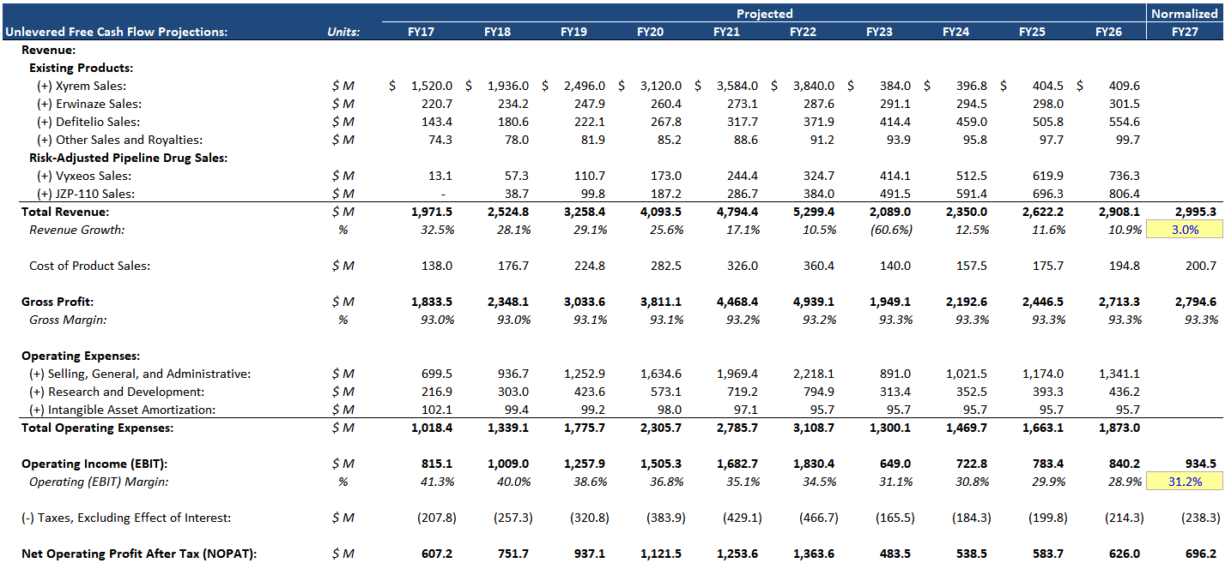
Management Case – Financial Projections
($ USD in Millions)

Slide 6
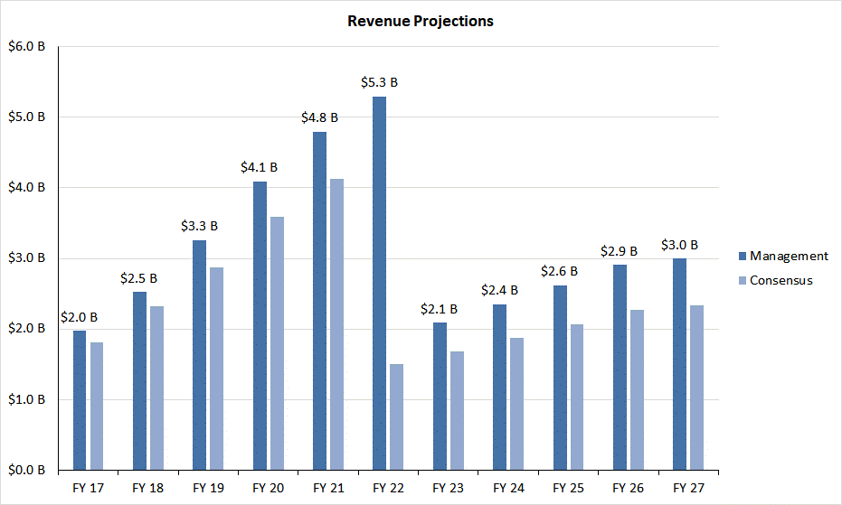
Revenue Projections: Management vs. Consensus
($ USD in Billions)

Slide 7
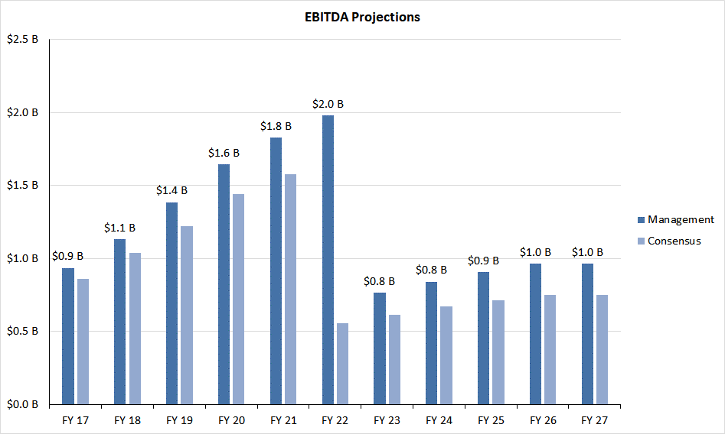
EBITDA Projections: Management vs. Consensus
($ USD in Billions)

Slide 8
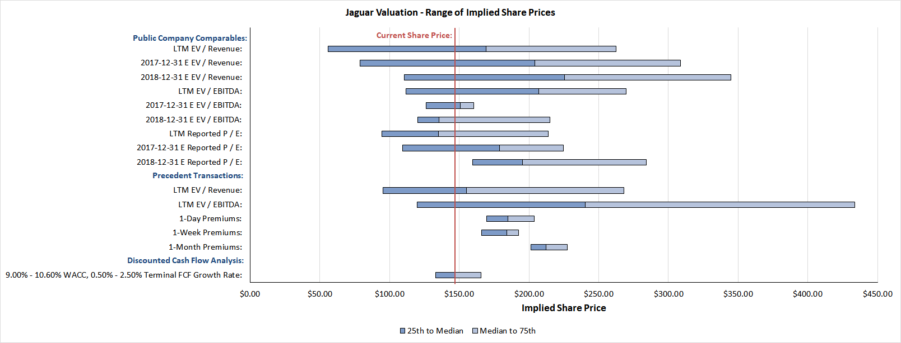
Valuation Summary – Management Case
($ USD in Dollars as Stated)
All market data as of August 16, 2017
Given that Jaguar’s revenue growth, EBITDA growth, and EBITDA margins exceed those of its peer companies, we believe that the 75th percentile multiples are the most applicable ones here

Slide 9
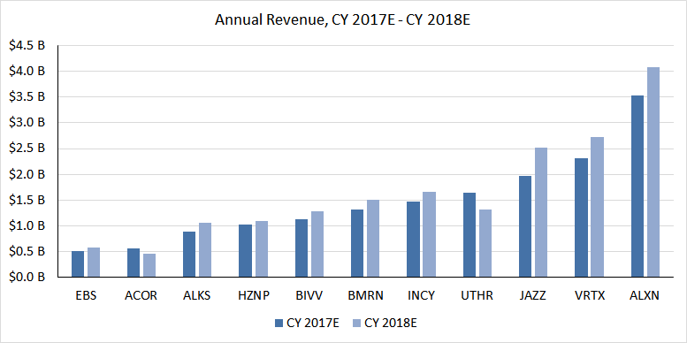










Jaguar Comparable Public Companies
Specialty Pharmaceutical Companies That Sell Primarily Branded Drugs, with LTM Revenue Between $500 Million and $5 Billion
($ USD in Billions)
Comparable Public Companies – Revenue, CY 2017E – CY 2018E⁽¹⁾
(1) Financial data as of August 16, 2017.

Slide 10
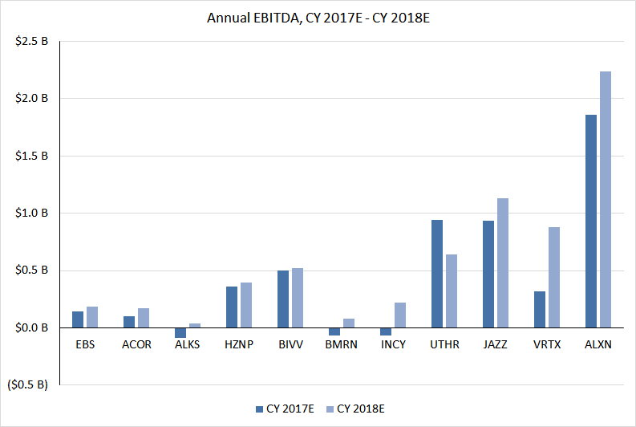




Jaguar Comparable Public Companies
Specialty Pharmaceutical Companies That Sell Primarily Branded Drugs, with LTM Revenue Between $500 Million and $5 Billion
($ USD in Billions)
Comparable Public Companies – EBITDA, CY 2017E – CY 2018E⁽¹⁾
(1) Financial data as of August 16, 2017.

Slide 11
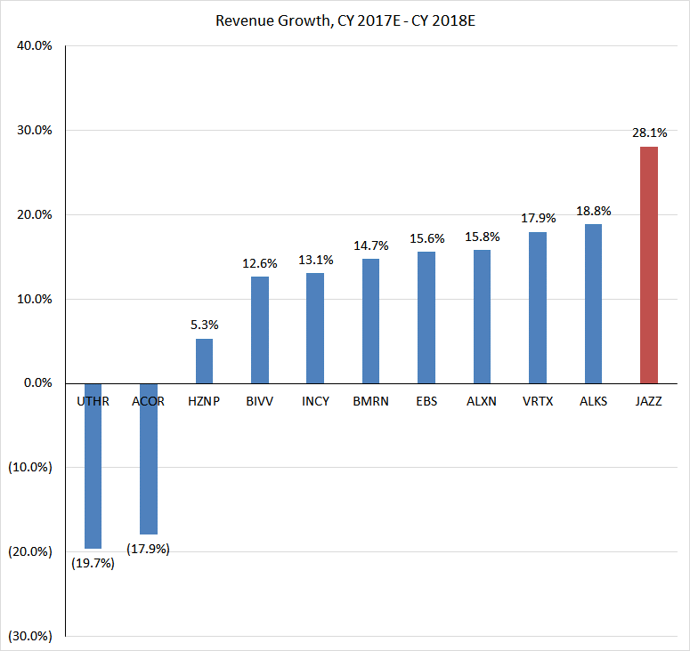
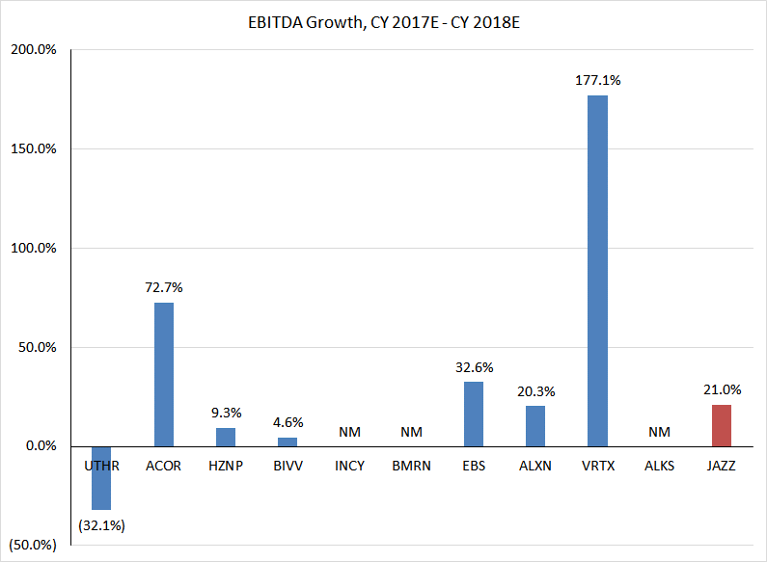




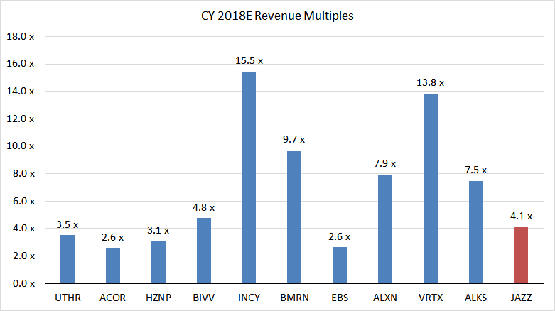
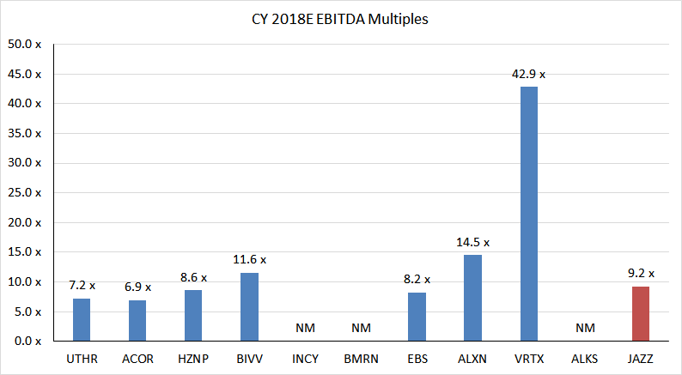
Jaguar Comparable Public Companies
Specialty Pharmaceutical Companies That Sell Primarily Branded Drugs, with LTM Revenue Between $500 Million and $5 Billion
Comparable Public Companies – Growth and Valuation Multiples, CY 2017E – CY 2018E⁽¹⁾
(1) Financial data as of August 16, 2017.

Slide 12
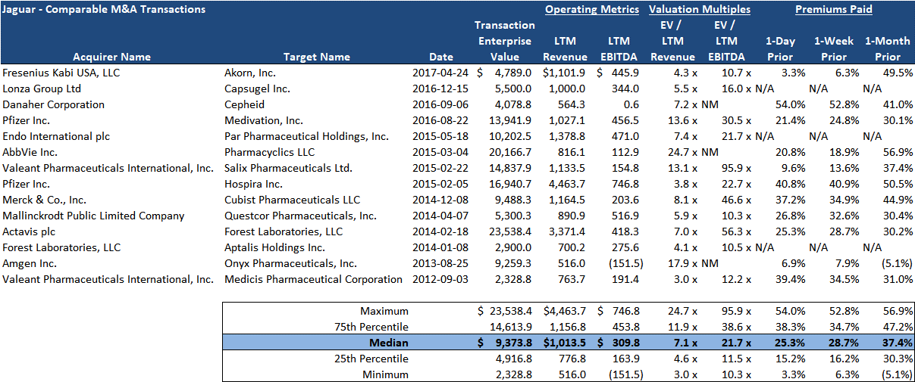
Jaguar Precedent Transactions
U.S. and Canadian Pharmaceutical Sellers with $500 Million – $5 Billion in LTM Revenue, Aug. 16, 2012 – Aug. 16, 2017
($ USD in Millions)

Slide 13
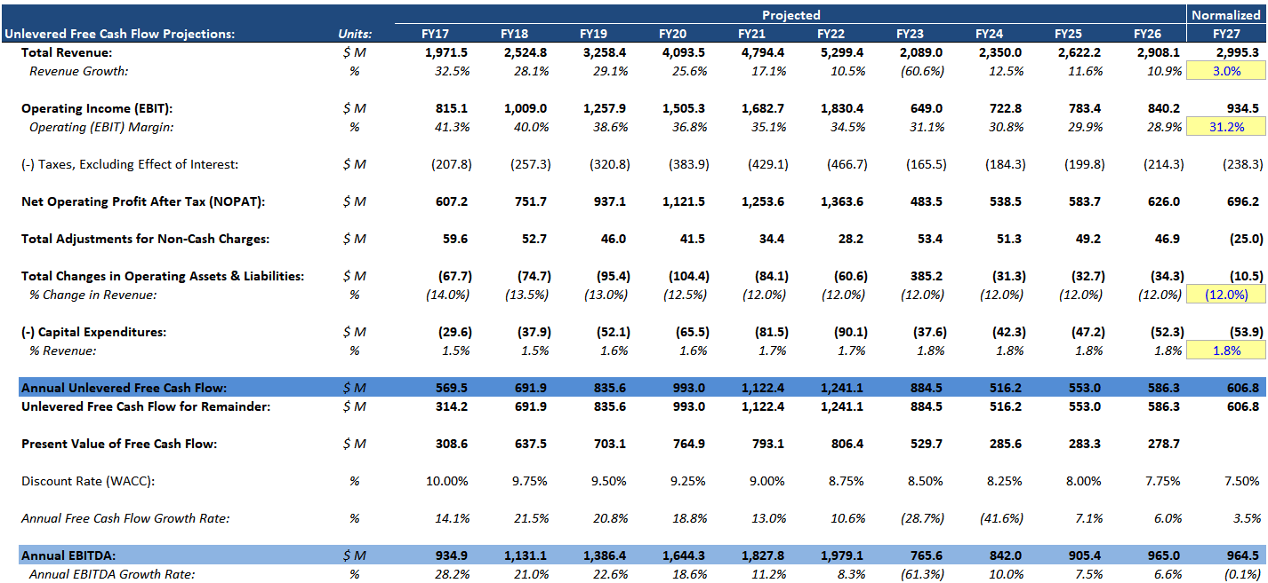
Jaguar DCF Analysis – Free Cash Flow Projections
($ USD in Millions)

Slide 14
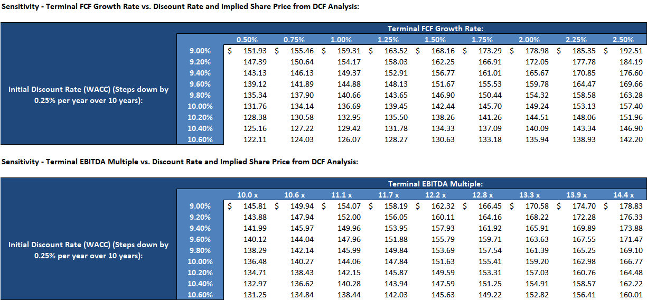
Jaguar DCF Analysis – Sensitivities
($ USD in Dollars as Stated)
Output from the sensitivities below is based on the Management forecasts for Jaguar
Range of Discount Rates is based on a 10.13% median WACC of comparable public companies and a 9.76% median WACC with Jaguar’s current capital structure; Terminal Multiples and Growth Rates are linked to comparables

Slide 15
Summary Profile of Equity Shareholders
Commentary:
Gross Common Share Count: 58,739,693⁽¹⁾
Major institutional investors represent approximately 97% of share ownership
Largest institutional shareholders include:
  Putnam: 8,304,110 (14.1%)
  Fidelity: 8,290,410 (14.1%)
  Vanguard: 4,677,223 (8.0%)
  BlackRock: 3,110,681 (5.3%)
  Insiders own 2-3% of shares outstanding:
    Seamus Mulligan (Director): 1,048,008 (1.8%)
    Bruce Cozadd (CEO): 226,199 (0.4%)
    Given the lack of activist investors and the high percentage of shares held by traditional investment managers, the chances of a challenge to a potential deal are low
Individuals /
Banks / Investment
Other:
Insiders:
Banks:
3%
2%
2%
Hedge Funds:
12%
Investment
Managers:
81%
Source: Company proxy statements, investor filings, and Capital IQ.
(1) As of June 30, 2017 10-Q filing.

Slide 16
Valuation Conclusions
#1
“75th Percentile” Valuation is Justified
The company’s margins and growth rates exceed the median figures of its peer companies, indicating that it should be valued in-line with the 75th percentile multiples
#2
Goal: $200 / Share
This price represents a 35%+ premium to Jaguar’s current share price; greater upside might be possible with a highly complementary partner
#3
Discounted Cash Flow (DCF) Analysis
Implied value is between $110 and $160 / share, but these projections do not include possible synergies in an M&A deal and, as such, they likely undervalue Jaguar
#4
Premiums Paid Analysis
Premiums Paid indicate a median implied share price of $180 – $200, with a 75th percentile implied share price in the $200 – $220 range

Slide 17
Potential Strategic Partners
Size, ability to pay, product/pipeline, and strategic fit should all be considered
At $200 / share, Jaguar would be worth an Enterprise Value of nearly $15 billion; therefore, potential partners should be able to drawn on this much Cash and Debt to fund the deal
Both branded and generics companies should be considered, in light of recent M&A activity
Tier 1 Potential Partners
Tier 2 Potential Partners
Market Cap:
Significantly larger than Jaguar
Closer to Jaguar’s size
Ability to Pay:
Capable of paying at least $10-15 billion in Cash and Debt
May have to issue Stock to fund the full purchase price
Strategic Fit:
Solid product and pipeline fit
Solid product and pipeline fit

Slide 18











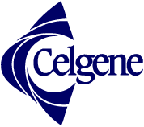
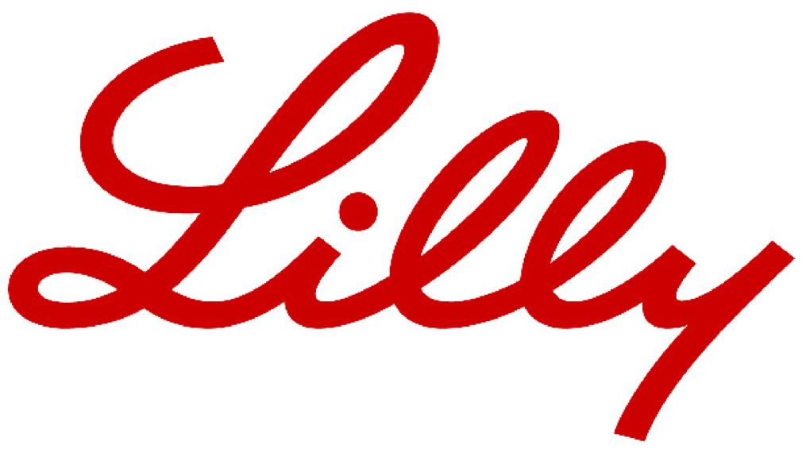








Potential Strategic Partners
Tier 1 Potential Partners
Tier 2 Potential Partners

Slide 19
Key Recommendations
We recommend engaging in targeted discussions with the Tier 1 candidates and assessing their receptiveness to M&A discussions
At the same time, Goldman Stanley will reach out to Tier 2 candidates and introduce Jaguar as a potential partner
M&A process with Tier 1 candidates will take significantly longer due to the size of the companies, so we recommend conducting both processes simultaneously
Depending on the responses from Tier 1 and Tier 2 candidates, Goldman Stanley and Jaguar may do additional research to determine other potential partners and then approach them
Targeted Sell-Side M&A | Broad Sell-Side M&A
< 5 potential partners | 10 – 100 potential partners
6 – 12 months | Time required is highly variable
Close-ended | Iterative process
Higher success probability | Lower success probability

Slide 20
Process Recommendations
Specialized Negotiations With One Party
Highly Targeted
Process
Targeted Discussions + Broader Search
Broad M&A Process
Broad
Marketing
RECOMMENDED
Combination of targeted discussions plus broader search conducted in background maximizes success probability and minimizes disruption to Jaguar
Additional parties contacted depend on responsiveness of Tier 1 and Tier 2 partners
Interested parties would sign NDAs and then proceed into due diligence and valuation discussions with Jaguar

